Slide 1
It’s Time to Enroll Get to Know Your VSP Vision Benefits.
City of San José
Notes:
Generic Script:
Thank you for taking the time to learn more about your benefit offering through VSP Vision Care! With VSP Vision Care, our goal is to help you see well and be well for a lifetime of good vision. Let’s take a look at the great benefits available to you.

Slide 2
City of San José VSP Plan Offering
The City of San José and VSP provide you with a choice of either the Signature Plan or the Choice Plan.
Choose the plan that works
best for you.
Notes:
Script
Members get access to care that’s constantly improving, because VSP never stops innovating. Since the very beginning, VSP has been raising the bar in vision care. In fact, we created the very first vision insurance plan, all with the goal of helping people see by expanding access to affordable eye care.​

Slide 3
Your VSP Plan Options at a Glance
 | SIGNATURE PLAN | CHOICE PLAN
 | WellVision Exam covered every calendar year with $10 Copay (exam, lenses & frame) Retinal imaging exam covered in full every calendar year for no more than $35
 | Additional exams & services beyond routine care for immediate issues from pink eye to sudden changes in vision or to monitor ongoing conditions. Coordination with your medical coverage may apply.
 | $150 Frame allowance $170 Featured frame brand allowance $80 Walmart®/Sam's Club®/Costco® Every other calendar year | $150 Frame allowance $170 Featured frame brand allowance $80 Walmart®/Sam's Club®/Costco® Every calendar year
 | Fully covered single vision, bifocal, or trifocal lenses Every calendar year | Fully covered single vision, bifocal, or trifocal lenses Every calendar year
 | Impact-resistant lenses for dependent children Standard Progressive lenses – Covered in Full Premium/Custom Progressive lenses $80 - $160 Average savings of 40% on lens enhancements | Impact-resistant lenses Standard Progressive lenses – Covered in Full Premium/Custom Progressive lenses $95 -$175 Average savings of 30% on lens enhancements
 | $105 allowance for contact lenses $60 copay for contact lens exam (fitting & eval) 15% off contact lens exam Every calendar year | $105 allowance for contact lenses $60 copay for contact lens exam (fitting & eval) 15% off contact lens exam Every calendar year
Exams
Essential Medical Eye Care
Frame Allowance
Lenses
Lens Enhancements
Contact Lens Allowance (instead of glasses)
Notes:
Generic Script:
Here’s a look at the benefits available to you. When you choose a VSP vision plan, you will receive a WellVision Exam covered every year.

Slide 4
Essential Medical Eye Care
Here’s what’s covered:
Fully covered retinal imaging for members with diabetes who do not have diabetic eye disease.
Exams and services to treat immediate issues like pink eye and sudden changes in vision.
Treatment options to monitor ongoing conditions such as dry eye, diabetic eye disease, glaucoma, and more.
This coverage is supplementary and in most cases your health insurance will be billed first. You may be able to coordinate with your VSP benefits in order to help reduce out-of-pocket costs. If your VSP network doctor doesn’t participate with your medical insurance plan, VSP has you covered with only the cost of your copay.*
*$20 standard copay for medical exams. Other covered services are covered-in-full, including retinal screening for members with diabetes.
Notes:
Generic Script:
With Essential Medical Eye Care, here’s what’s covered:
Fully covered retinal screening for members with diabetes who do not have diabetic eye disease
Exams and services to treat immediate issues like pink eye and sudden changes in vision
Treatment options to monitor ongoing conditions such as dry eye, diabetic eye disease, glaucoma, and more
This coverage is supplementary and in most cases your health insurance will be billed first. You may be able to coordinate with your VSP benefits in order to help reduce out-of-pocket costs. If your VSP doctor doesn’t participate with your medical insurance plan, VSP has you covered with only the cost of your copay.

Slide 5
Retinal Screening
Retinal screening photos are images of the inside of the eye that are used as baseline documentation of a healthy eye or to screen for potential disease(s).
These images can be compared year after year to monitor even the most subtle changes in the eyes, helping detect signs of eye disease and systemic disease as early as possible.
Copay of $35
*Applies only if your employer has a VSP supplemental medical eye care plan
Notes:
Generic Script:
Finding retinal disorders early is critical to potentially preventing serious disease progression and even vision loss. The digital imaging system takes a picture of the inside of your eye and helps your VSP network doctor detect and manage eye and health conditions like–glaucoma, diabetes, and macular degeneration.

Slide 6
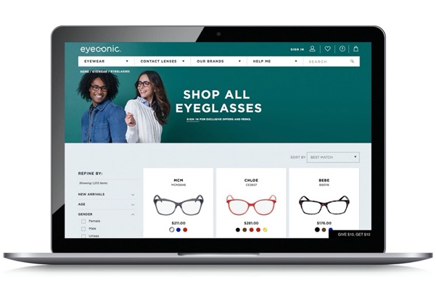
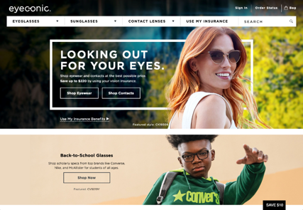
Eyeconic
As a VSP-owned company, Eyeconic seamlessly connects your VSP vision benefits to your account.
Eyeconic offers a variety of well-known brands and contact lenses. Choose from more than 70 eyewear brands like Calvin Klein, Cole Haan, Nike, and more. Find your product, customize your order and we do the rest. Start saving today at eyeconic.com® today.
Notes:
Generic Script:
As a VSP-owned company, Eyeconic is the only website that seamlessly connects VSP vision benefits to a members’ account. By applying your vision benefits, you see savings in real time.
Save time and money on quality eyewear with a few easy clicks.
1. Connect your vision insurance
2. Select your product
3. Upload your prescription or provide your doctors contact information and we’ll take care of the rest.
Eyeconic offers a variety of well-known name brands and contact lenses. Choose from over 70 eyewear brands and over 1600 styles.

Slide 7
Exclusive Member Extras
Get the Savings You Need.
Visit vsp.com to see all the Exclusive Member Extras. VSP puts members first by providing you with exclusive special offers from leading industry brands, totaling more than $3,000 in savings. Discover great deals on glasses, sunglasses, contact lenses, and more.
Enjoy an Extra $20 on Featured Frame Brands. Enjoy an Extra $40 on Featured Frame Brands. Save up to 40% on popular lens enhancements.* Offers vary based on state and benefit plan. Brands and offers subject to change.
*Savings based on doctor’s retail price and vary by plan and purchase selection; average savings determined after benefits are applied. Ask your VSP network doctor for more details.
Notes:
Generic Script:
At VSP, our commitment to your well-being extends to your financial wellness. Members get access to Exclusive Member Extras--up to $3,000 in savings on leading industry brands. Plus, VSP members always get an extra $20 to spend on featured frame brands. That way you get the low-out-of-pocket costs your family needs.
Exclusive Member Extras includes:
Special deal on glasses – extra $50 on featured frame brands
Up to 40% off lens enhancements
Visit vsp.com to see additional savings on contacts, LASIK, diabetes care, hearing aids, and financing
Offers vary based on state and benefit plan. Brands and offers subject to change.

Slide 8
Savings On Hearing Aids
Like vision loss, hearing loss can have a huge impact on your quality of life. TruHearing® makes hearing aids affordable by providing exclusive savings to all VSP Vision Care members. As a VSP member, you can save up to 60% on a pair of hearing aids with TruHearing. Your dependents and even extended family members are eligible too. Learn more about this VSP Exclusive Member Extras at truhearing.com/vsp.
Notes:
Generic Script:
Like vision loss, hearing loss can have a huge impact on your quality of life. As a VSP member, you have access to savings on hearing aids through VSP’s partnership with TruHearing. Visit truhearing.com/vsp to learn more.
Legal Disclaimer:
VSP is providing information to its members but does not offer or provide any discount hearing program. The relationship between VSP and TruHearing is that of independent contractors. VSP makes no endorsement, representations, or warranties regarding any products or services offered by TruHearing, a third-party vendor. The vendor is solely responsible for the products or services offered by them. If you have any questions regarding the services offered here, you should contact the vendor directly.
TruHearing offers individuals the opportunity to purchase hearing aids at discounted prices, including individuals covered by self-funded health plans not subject to state insurance or health plan regulations. TruHearing is not insurance and not subject to state insurance regulations. TruHearing provides discounts to certain healthcare groups for hearing aid sales and services; TruHearing provides fitting, programming, and three adjustment visits at no cost; the member is obligated to pay for testing, and all post-fitting hearing care services, but will receive a discount from those healthcare providers who have contracted with TruHearing. Not available directly from VSP in the states of Washington and California.

Slide 9
Convenient Access You Want
With thousands of in-network doctors, it’s easy to find an eye doctor near you.​ With Even More Options
Maximize your benefits at a Premier Program location (at no extra cost) including thousands of private practice doctors and more than 700 Visionworks® retail locations nationwide.
Exclusive bonus offers and savings
A wide selection of featured frame brands
Advanced eye exam technology, like retinal imaging
Notes:
Generic Script:
No matter where you’re located, you have convenient access to a VSP provider.
As a member, you can maximize your benefits when you visit a Premier Program location, including:
Exclusive bonus offers available only at Premier Program locations
A wide selection of featured frame brands, backed by a one-year worry-free warranty if your glasses are broken or damaged
Access to the latest in high-definition technology with UNITY® digital lenses available
Advanced eye exam technology, like retinal imaging

Slide 10
OUT OF NETWORK REIMBURSEMENT
SIGNATURE PLAN
Exam - Up to $50 Single Vision Lenses – Up to $50 Lined Bifocal Lenses – Up to $75 Lined Trifocal Lenses – Up to $100 Progressive Lenses – Up to $75 Frame – Up to $70 Elective Contact Lenses – Up to $105 (contacts are instead of glasses)
CHOICE PLAN
Exam - Up to $45 Single Vision Lenses – Up to $30 Lined Bifocal Lenses – Up to $50 Lined Trifocal Lenses – Up to $65 Progressive Lenses – Up to $50 Frame – Up to $70 Elective Contact Lenses – Up to $105 (contacts are instead of glasses)
Get the most out of your benefits and
greater savings with a VSP network doctor
Notes:
Script
Both plans offer out-of-network reimbursement. Get the most out of your benefits and greater savings with a VSP network doctor.

Slide 11
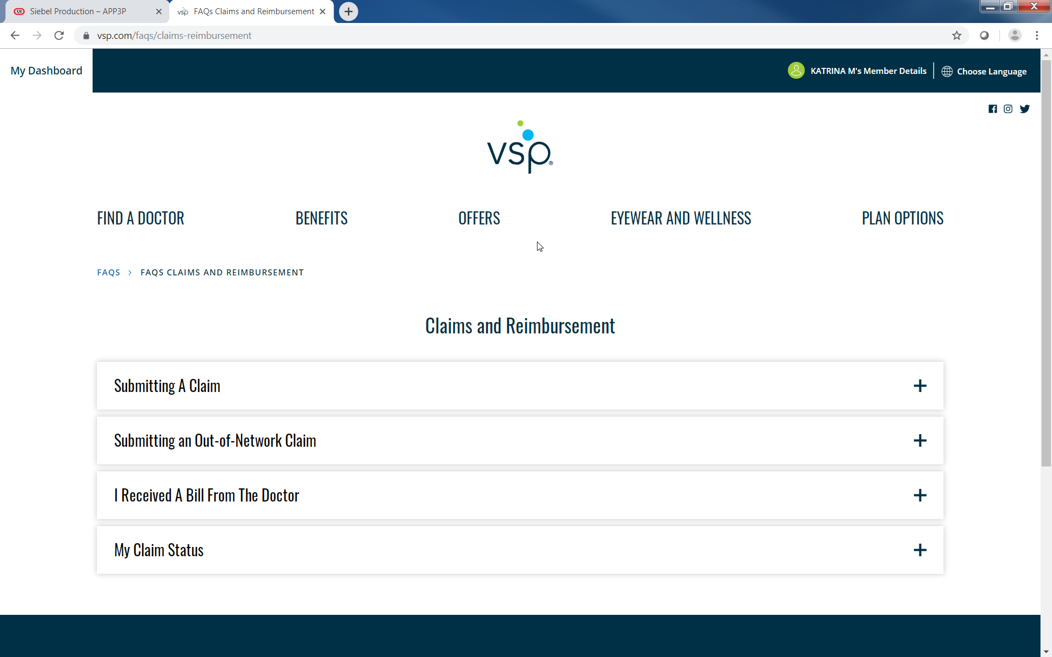
OON CLAIMS SUBMISSION
Log in to your account at www.vsp.com
Notes:
Script
To submit an out-of-network claim, simply log into your account at vsp.com, where you can submit your claim, and track the progress and status of your claim.

Slide 12
Using Your Benefit is Easy
Once you’re enrolled…
Create an account at vsp.com and review your personalized benefit information.
You can find a VSP in-network doctor by visiting vsp.com or calling 800.877.7195.
At your appointment, simply tell them you have VSP. No ID card needed—and we’ll take care of the rest! There are no claim forms to fill out when you see a VSP network doctor.
Notes:
Generic Script:
And using your VSP benefit is easy. Once your plan is effective, create an account on vsp.com to review your personalized benefit information and easily search for an in-network doctor so you can find a provider who's right for you. And don’t forget you can maximize your benefits when you visit a Premier Program location. Then, at your appointment, simply tell the doctor’s office you have VSP. There’s no ID card needed or claim forms to complete when you see a VSP network doctor.

Slide 13
VSP helps you see well and be well with the coverage and quality care you deserve.
Questions? Contact us. Call 800.877.7195 or visit VSP.com.
©2022 Vision Service Plan. All rights reserved. VSP, WellVision Exam, and "See Well. Be Well." are registered trademarks of Vision Service Plan. All other brands or marks are the property of their respective owners. 102051 VCCM
Classification: Confidential
Notes:
Generic Script:
VSP helps you see well and be well with the coverage and quality care you deserve. To learn more, contact us by calling VSP Member Services or by visiting us online at vsp.com.

